Slide 1
Spark SQL

Slide 2
Introduction
Spark SQL is Spark module for structured data processing.
It runs on top of Spark Core.
It offers much tighter integration between relational and procedural processing, through declarative DataFrame and Datasets API.
These are the ways which enable users to run SQL queries over Spark.
Apache Spark SQL integrates relational processing with Sparks functional programming.
Spark SQL blurs the line between RDD and relational table.

Slide 3
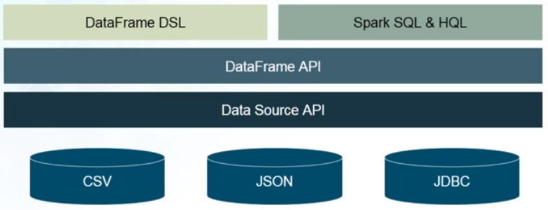
Spark SQL Architecture

Slide 4
What is Apache Spark SQL?
DataFrame API and Datasets API are the ways to interact with Spark SQL. As a result, Apache Spark is accessible to more users and improves optimization for current ones.
It allows developers to import relational data from Hive tables and parquet files, run SQL queries over imported data and existing RDDs and easily write RDDs out to Hive tables or Parquet files.
Spark SQL introduces extensible optimizer called Catalyst as it helps in supporting a wide range of data sources and algorithms in Bigdata.

Slide 5
Catalyst Optimizer
It is the newest and most technical component of Spark SQL.
A catalyst is a query plan optimizer. It provides a general framework for transforming trees, which performs analysis/evaluation, optimization, planning, and runtime code spawning.
Catalyst supports cost based optimization and rule-based optimization.
It makes queries run much faster than their RDD counterparts.
A catalyst is a rule-based modular library. Each rule in framework focuses on the distinct optimization.
The Spark SQL Catalyst Optimizer improves developer productivity and the performance of their written queries.

Slide 6
DataFrames – Introduced in Spark 1.3
A DataFrame is similar/identical to a table in a relational database but with richer optimization
Spark DataFrames evaluates lazily like RDD Transformations in Apache Spark.
It is a data abstraction and domain-specific language (DSL) applicable on the structure and semi-structured data.
It is a distributed collection of data in the form of named column and row.
A DataFrame is a Dataset organized into named columns.
Any operation on DataFrame results in DataFrame only.
Like RDD, DataFrames are also immutable.
Available in Java, Python, Scala and R.

Slide 7
Datasets – Introduced in Spark 1.6
Extension of DataFrames
Provides the benefits of RDDs (strong typing, ability to use powerful lambda functions) with the benefits of Spark SQL’s optimized execution engine.
A Dataset can be constructed from JVM objects and then manipulated using functional transformations (map, flatMap, filter, etc.).
The Dataset API is available in Scala and Java. Python does not have the support for the Dataset API. But due to Python’s dynamic nature, many of the benefits of the Dataset API are already available (i.e. you can access the field of a row by name naturally row.columnName). The case for R is similar.
Offers compile-time safety, which is not available in DataFrames

Slide 8
Why DataFrames?
DataFrame is one step ahead of RDD since it provides memory management and optimized execution plan.
a. Custom Memory Management: This is also known as Project Tungsten. A lot of memory is saved as the data is stored in off-heap memory in binary format. Apart from this, there is no Garbage Collection overhead. Expensive Java serialization is also avoided.
b. Optimized Execution plan: This is also known as the query optimizer. Using this, an optimized execution plan is created for the execution of a query. Once the optimized plan is created final execution takes place on RDDs of Spark.

Slide 9
SQLContext, Hive Context and JDBC Datasource(Version 1(Version 2-SparkSession spark))
SQLContext is the entry point for working with structured data (rows and columns) in Apache Spark. It Allows the creation of DataFrame objects as well as the execution of SQL queries.
Working with Hive tables, Hive Context is a descendant of SQLContext. Hive Context is more battle-tested and provides a richer functionality than SQLContext.
In Apache Spark, JDBC data source can read data from relational databases using JDBC API. It has preference over the RDD because the data source returns the results as a DataFrame, can be handled in Spark SQL or joined beside other data sources.

Slide 10
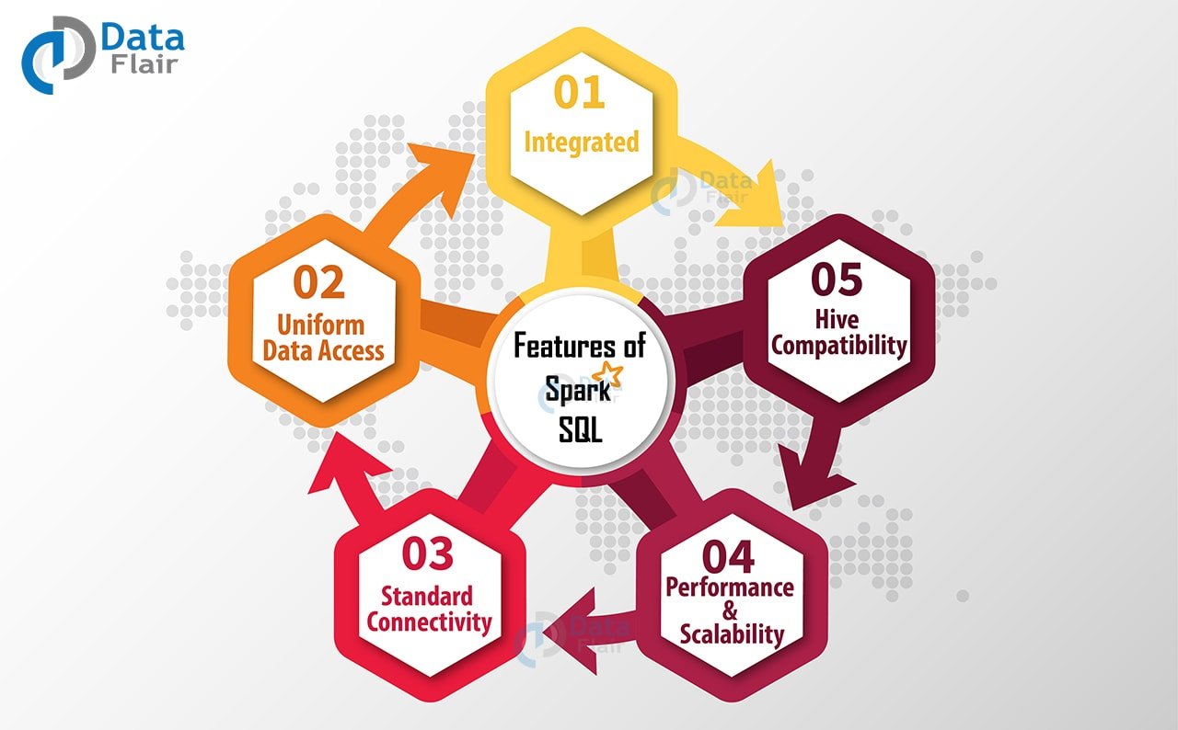

Slide 11
i. Integrated
Logically mix SQL queries with Spark programs. Apache Spark SQL allows to query structured data inside Spark programs, using SQL or DataFrame API.
ii. Uniform Data Access
Spark DataFrames and SQL supports a common way to access a variety of data sources, like Hive, Avro, Parquet, ORC, JSON, and JDBC. Hence Spark SQL can join data across these sources.
iii. Hive Compatibility
Runs unmodified Hive queries on current data. Spark SQL rewrites the Hive frontend and meta store, allowing full compatibility with current Hive data, queries, and UDFs.

Slide 12
iv. Standard Connectivity
Connect through JDBC or ODBC. A server that supports industry norms JDBC and ODBC connectivity for business intelligence tools.
v. Performance & Scalability
Apache Spark SQL incorporates a cost-based optimizer, code generation, and columnar storage to make queries agile alongside computing thousands of nodes using the Spark engine, which provides full mid-query fault tolerance.

Slide 13
HandsOn

Slide 14
Demonstration in local mode
Start spark in local mode using ‘pyspark’ command.
from pyspark.sql import SparkSession //May not be needed if Sparksession object is already created.
spark=SparkSession.builder.appName("Basics").getOrCreate()
df=spark.read.csv('file:///home/pinkal/Downloads/booklist.csv')
df.show()
df.columns
df.describe()
df.printSchema()

Slide 15
Demonstration in Standalone mode with HDFS as storage
Start HDFS deamons using ‘start-dfs.sh’
Start spark master using ‘start-master.sh’
Start worker using ‘start-slave.sh spark://hadoop-master:7077’
Start python shell using ‘pyspark –master spark://hadoop-master:7077’
from pyspark.sql import SparkSession //May not be needed if Sparksession object is already created.
spark=SparkSession.builder.appName("Basics").getOrCreate()
df=spark.read.csv(‘/PartitionerDemo/input/partitioner_input.csv')
df.show() //Shows first 20 lines
df.columns
df.describe()
df.printSchema()
df.head(2) //Returns first two row object

Slide 16
Customized Schema
By Default, Spark automatically tries to infer schema from the file.
But if there is a need to have specific schema, then we will have to specify schema explicitly.
In this case, spark will not automatically infer schema, instead it will only read the created schema and will try to fit data into that schema.

Slide 17
Using StructType
from pyspark.sql.types import StructField,StringType,IntegerType,StructType
data_schema = [StructField("id",IntegerType(),True),StructField("title",StringType(),True),StructField("author",StringType(),True),StructField("format",StringType(),True),StructField("price",IntegerType(),True)]
final_struct=StructType(fields=data_schema)
df=spark.read.csv("file:///home/pinkal/Downloads/booklist.csv",schema=final_struct)
df.printSchema()
df.columns

Slide 18
Some more operations
df[“id”]
type(df[‘id’])
df.select(‘id’).show()
df.withColumn("newid",df["id"]).show()
df.withColumn("doubleid",df["id"]*2).show()
df.show() //Note original dataframe is not changing
df.withColumnRenamed('id','uniqueid').show()

Slide 19
Working with SQL
df.createOrReplaceTempView("book")
sql_results = spark.sql("Select * from book")
sql_results.show()

Slide 20
References
https://data-flair.training/blogs/apache-spark-sql/
https://blog.bi-geek.com/en/spark-sql-optimizador-catalyst/
https://www.edureka.co/community/53384/spark-dataframe-vs-dataset

